Slide 1
#TechforPeople
Notes:
Capa com animação

Slide 2

Blazor WebAssembly an Overview (in 10 slides or less)
A Single Page Application Framework for .Net
Diogo Tomaz / 15-04-2020

Slide 3

What is it?
Blazor is a framework relying on the Razor Engine
Currently it comes in 4 flavours:
Blazor Server
⦿ Target: Browsers ✔Status: Production-ready
Blazor Electron
⦿ Desktop ✘Experimental
Mobile Blazor Bindings
⦿ Mobile ✘Experimental
Blazor Web Assembly (This will be the subject of this presentation)
⦿ Browser ! Preview, schedule release: May 2020

Slide 4



First things first, what’s WebAssembly (Wasm)
It is a binary format that web browsers understand
It is a standard and available in all modern browsers (even Mobile).
IE not included
Runs in the same sandbox as JS runtime
Shares the same limitations, security, unable to to access hardware
You usually do not write WebAssembly, you compile to it (Wasm Module)
WASM can perform up to 20x times faster than JS and 20% slower than native browser code
WASM should be viewed as a compliment to JS, not a replacement
It is the second language to be natively understood by web browsers
JS was invented in December of 1995, so almost 25 years later
https://webassembly.org/

Slide 5
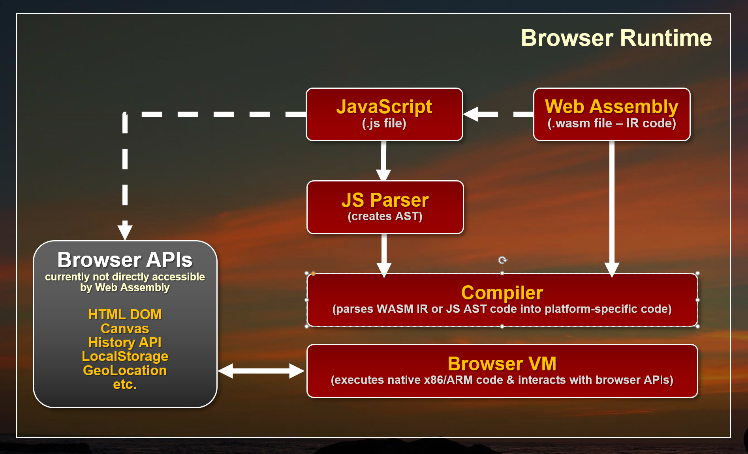
© Rick Strahl

Slide 6
WASM Module
Thou you can write in WebAssembly through a text version, a .wat file there are compiled version (machine readable) files, called .wasm
The latter contains the lower-level code produced by compilers of other languages
It does not need to be parsed like JS, since it's already byte-code
It is platform-agnostic code
There are many modules for different languages
https://github.com/appcypher/awesome-wasm-langs

Slide 7
The .Net WASM Module 🤘
There is a Mono compiled version of the .NET Runtime (dotnet.wasm) This module enables the execution of .NET Standard assemblies https://www.mono-project.com/news/2017/08/09/hello-webassembly/
How does Blazor fit in?
Your custom code, razor code and any other depending assemblies are loaded and executed through the dotnet.wasm
A file called dotnet.js is also loaded ahead, it's a minimalist JS file responsible for bootstrap and setup your application
For the usual Web Developer none of this complicated relation between Blazor + WebAssembly should matter 🤓

Slide 8
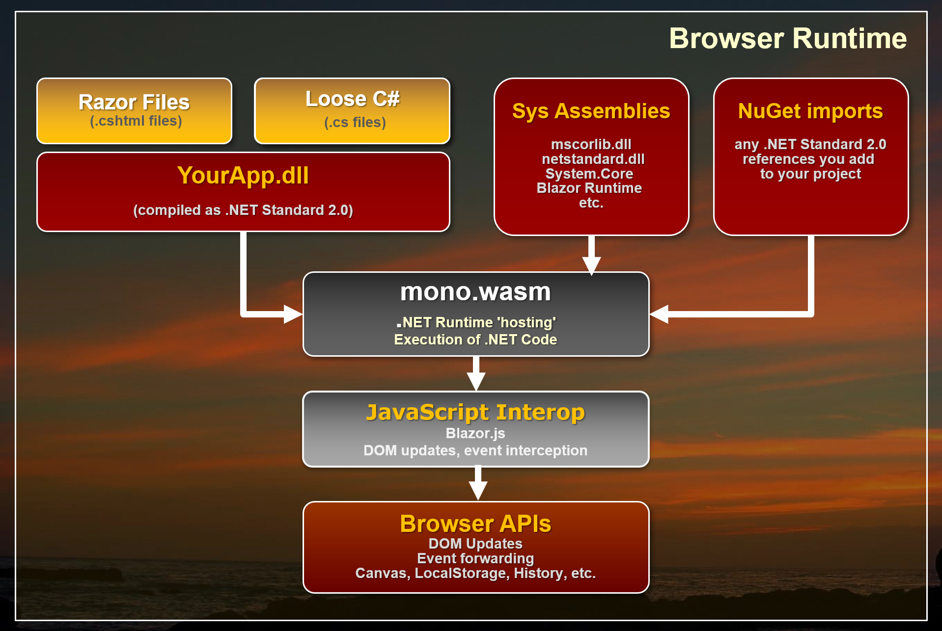
© Rick Strahl Note: Image proceeds Preview 2 of Blazor (mono.wasm is now dotnet.wasm and Razor files now have extension .razor)

Slide 9
The Dark side
What’s the catch? 👎
Blazor WebAssembly was built to be a SPA for rendering Razor pages on the client side.
Your code will be coupled to the Blazor framework, hence it's not a generic engine
DOM Manipulation still requires JS
JS and .NET can communicate, but through an interop service
There is an overhead at first load of the page, thou considerably less to full-featured frameworks such as Angular or Ember.
Still in Beta and undergoing a lot of changes/improvements

Slide 10

Always look on the bright side of life
Why should I use it? 👍
C# code runs in near native code experience in the browser
Reuse your stack for another type of development
Reuse code of back in front, reuse assemblies
Possibility to reuse Blazor code on other flavours
Lessens the need for JavaScript and all its (un)necessary packages
Your back-end guy can now move a bit closer to the Front-End
Your application is essentially static files, no need to hire more expensive servers to host them
Learning curve is not that steep, lots of familiar concepts with MVC+Razor.
All a board ...

Slide 11
DEMO 1 First Look

Slide 12
DEMO 2 Razor Components

Slide 13
DEMO 3 JS Interop

Slide 14
No soup for you
Soup Nazi

